Slide 1
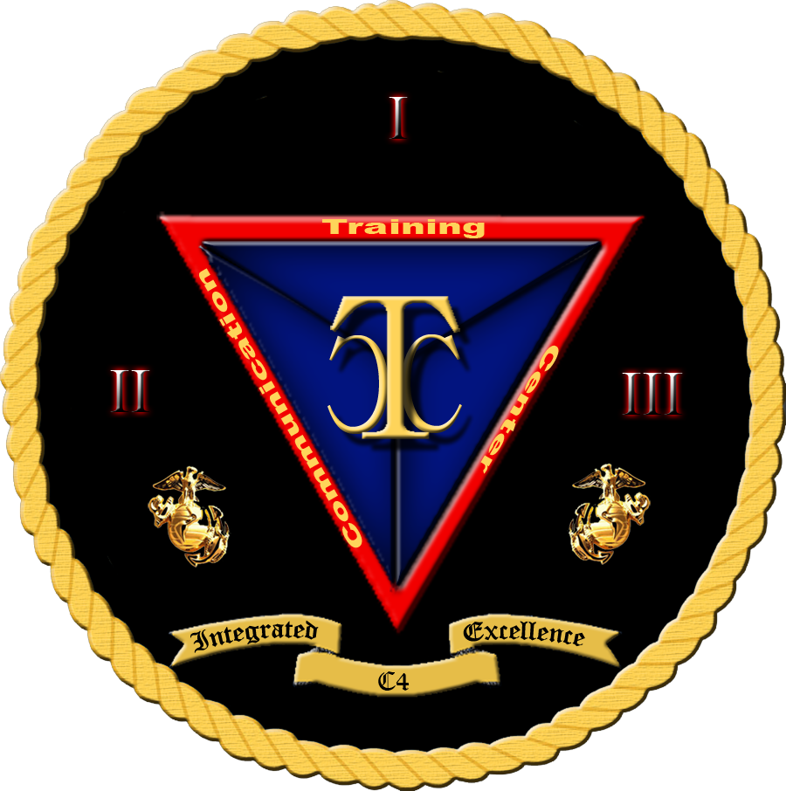

Security+
Exam SY0-601
Chapter 10
Virtualization and Cloud Security
Notes:
Gain Attention

Slide 2
Chapter 10 (Domain 2.2) Learning Objectives
Summarize virtualization and cloud computing concepts.
Cloud models
Infrastructure as a service (IaaS)
Platform as a service (PaaS)
Software as a service (SaaS)
Anything as a service (XaaS)
Public
Community
Private
Hybrid
Cloud service providers
Managed service provider (MSP)/managed security service provider (MSSP)
On-premises vs off-premises
Fog computing
Edge computing
Thin client
Containers
Microservices/API
Infrastructure as code
Software-defined networking (SDN)
Software-defined visibility (SDV)
Serverless architecture
Services integration
Resource policies
Transit gateway
Virtualization
Virtual machine (VM) sprawl avoidance
VM escape protection

Slide 3
Cloud Models
There are many different cloud deployment models.
Clouds can be created by many entities, both internal and external to an organization.
There are pros and cons to cloud-based computing.
For each case, a business analysis must be performed to determine the correct choice between cloud options and on-premises computing.

Slide 4
Models
Infrastructure as a Service (IaaS)
Platform as a Service (PaaS)
Software as a Service (SaaS)
Anything as a Service (XaaS)

Slide 5
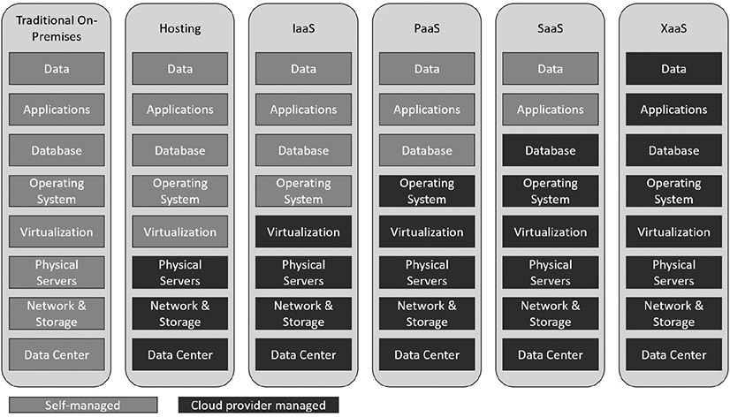
Level of Control in the Hosting Models

Slide 6
Cloud Systems
Public
The term public cloud refers to a cloud service that is rendered over a system open for public use.
Community
A community cloud system is one where several organizations with a common interest share a cloud environment for the specific purposes of the shared endeavor.
Private
Private clouds are essentially reserved resources used only by your organization—your own little cloud within the cloud.
Hybrid
A hybrid cloud structure is one where elements from private, public, and community cloud structures are combined.

Slide 7
Cloud Service Providers
Cloud service providers (CSPs) come in many sizes and shapes, with a myriad of different offerings, price points, and service levels.
There are the mega-cloud providers, Amazon, Google, Microsoft, and Oracle, which have virtually no limit to the size they can scale to when needed.
There are smaller firms, with some offering reselling from the larger clouds and others hosting their own data centers.
Each of these has a business offering, and the challenge is determining which offering best fits the needs of your project or company.

Slide 8
Managed Service Provider (MSP) / Managed Security Service Provider (MSSP)
A managed service provider (MSP) is a company that remotely manages a customer’s IT infrastructure.
A managed security service provider (MSSP) does the same thing as a third party that manages security services.
The scope of the engagement, what is in the details of the contract, is what is being provided by the third party, and nothing else.
Managed services provide the strength of a large firm but at a fraction of the cost that a small firm would have to pay to achieve the scale advantages of a large firm. So, obviously, there are advantages.
However, the downside is flexibility, as there is no room for change without renegotiating the contract for services.

Slide 9
On-Premises vs. Off-Premises
On-premises means the system resides locally in the building of the organization.
Whether it’s a virtual machine (VM), storage, or even a service, if the solution is locally hosted and maintained, it is referred to as “on-premises.”
The advantage is that the organization has total control of the system and generally has high connectivity to it. The disadvantage is that it requires local resources and is not necessarily easy to scale.
Off-premises or hosted services refer to having the services hosted somewhere else, commonly in a shared environment. Using a third party for hosted services provides you a set cost based on the amount of those services you use. This has cost advantages, especially when scale is included

Slide 10
Fog Computing
Fog computing is using someone else’s computers.
Fog computing is a distributed form of cloud computing, in which the workload is performed on a distributed, decentralized architecture.
Fog computing is an architecture where devices mediate processing between local hardware and remote servers.
It regulates which information is sent to the cloud and which is processed locally, with the results sent to the user immediately and to the cloud with its latency.
One can view fog computing as using intelligent gateways that handle immediate needs while managing the cloud’s more efficient data storage and processing.

Slide 11
Edge Computing
Edge computing refers to computing performed at the edge of a network.
Edge computing is similar to fog computing in that it is an adjunct to existing computing architectures—one that is designed for speed.
The true growth in edge computing has occurred with the Internet of Things (IoT) revolution.
Edge computing brings processing closer to the edge of the network, which optimizes web applications and IoT devices.

Slide 12
Thin Client
A thin client is a lightweight computer, with limited resources, whose primary purpose is to communicate with another machine.
Thin clients can be very economical when they are used to connect to more powerful systems.
Rather than having 32 GB of memory, a top-level processor, a high-end graphics card, and a large storage device on every desktop, where most of the power goes unused, the thin client allows access to a server where the appropriate resources are available and can be shared.
With cloud computing and virtualization, where processing, storage, and even the apps themselves exist on servers in the cloud, what is needed is a device that connects to that power and acts as an input/output device.

Slide 13
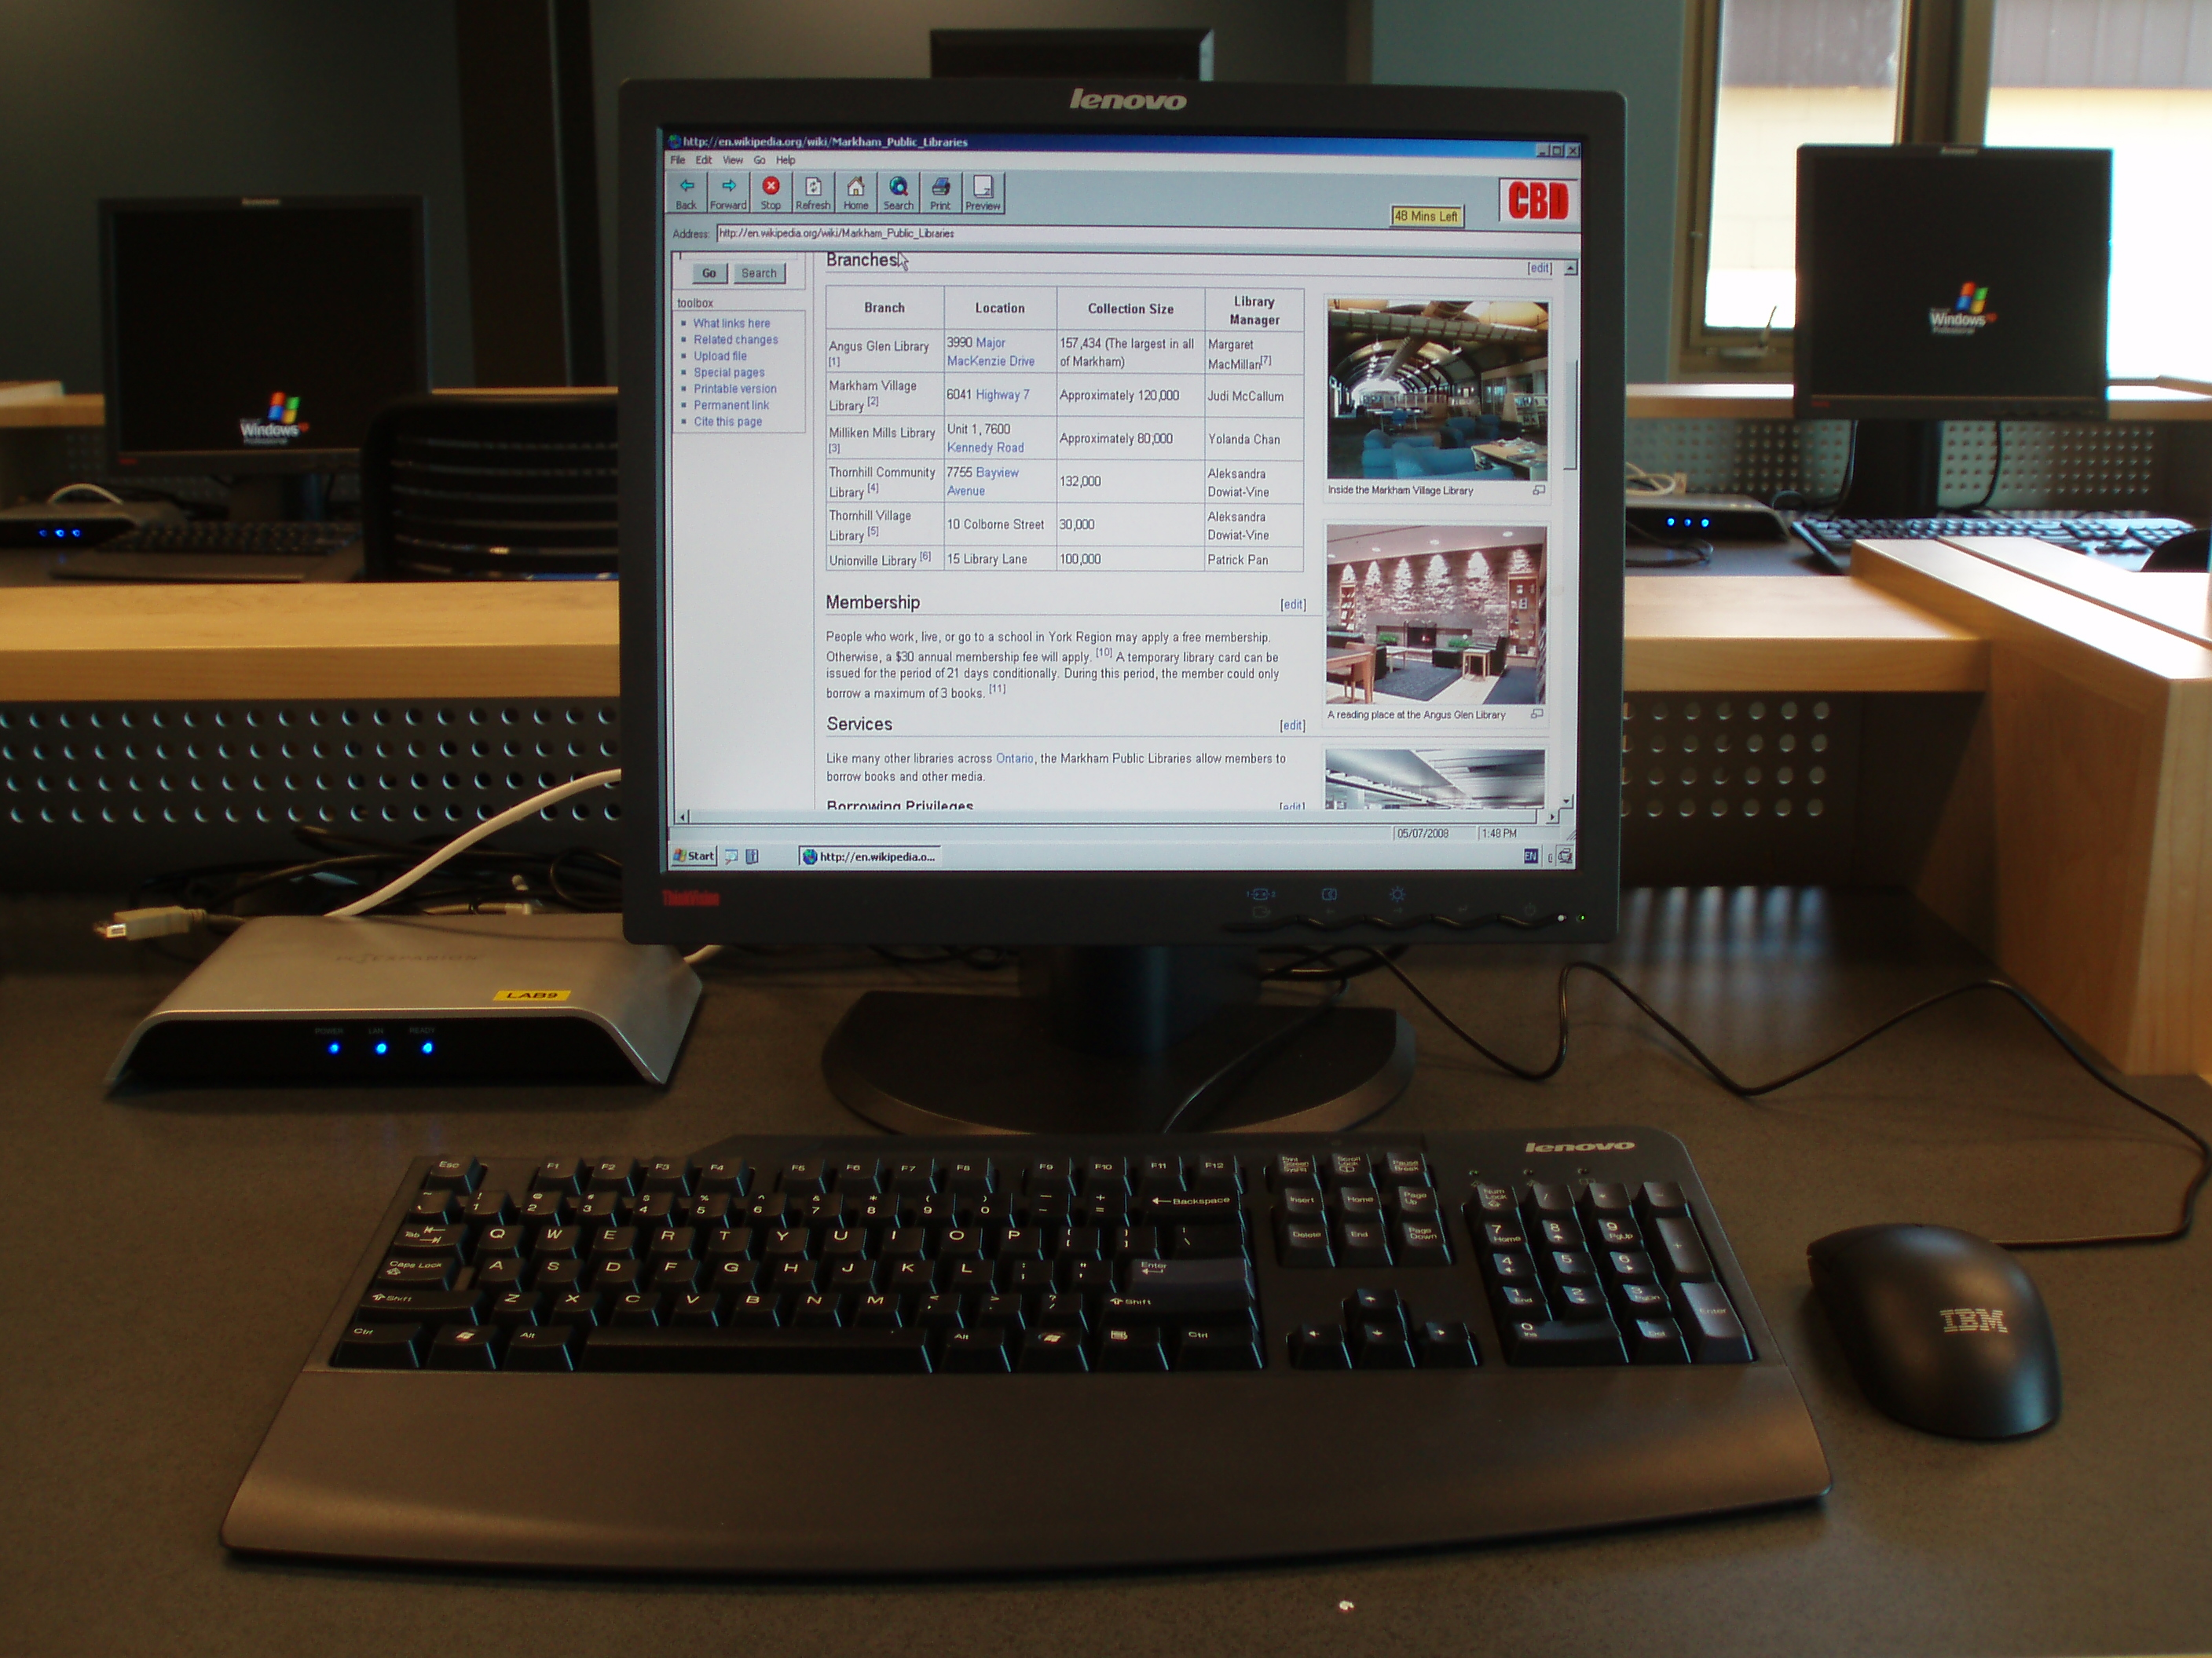
Thin Client

Slide 14
Containers
Virtualization enables multiple OS instances to coexist on a single hardware platform.
The concept of containers is similar, but rather than having multiple independent OSs, a container holds the portions of an OS that it needs separate from the kernel.
Therefore, multiple containers can share an OS, yet have separate memory, CPU, and storage threads, guaranteeing that they will not interact with other containers.
This allows multiple instances of an application or different applications to share a host OS with virtually no overhead. This also allows portability of the application to a degree separate from the OS stack.

Slide 15
Microservices/API
An application programming interface (API) is a means for specifying how one interacts with a piece of software.
If a service uses the representational state transfer (REST) API, then the defined interface is a set of four actions expressed in HTTP:
GET Get a single item or a collection.
POST Add an item to a collection.
PUT Edit an item that already exists in a collection.
DELETE Delete an item in a collection.

Slide 16
Microservices/API
Microservices is a different architectural style.
Rather than defining the inputs and outputs, microservices divide a system into a series of small modules that can be coupled together to produce a complete system.
Each of the modules in a microservices architecture is designed to be lightweight, with simple interfaces and structurally complete.
This allows for more rapid development and maintenance of code.

Slide 17
Infrastructure as Code
Infrastructure as code is the use of machine-readable definition files as well as code to manage and provision computer systems.
By making the process of management programmable, there are significant scalability and flexibility advantages.
Rather than having to manage physical hardware configurations using interactive configuration tools, infrastructure as code allows for this to be done programmatically.
A good example of this is in the design of software-defined networking.

Slide 18
Software-Defined Networking (SDN)
Software-defined networking (SDN) is a network architecture where the control plane and the data plane are separated.
This allows for networking hardware to be under programmatic control, even while processing data.
With SDN, a complete network programming stack exists, separate from data flows and programmable across the entire network.
A key element of SDN is network function virtualization (NFV). NFV is an architecture that virtualizes network services, such as routers, firewalls, and load balancers, as opposed to running them on dedicated, specific hardware.
Together, SDN and NFV create a fully functional network under the infrastructure as code architectural model.

Slide 19
Software-Defined Visibility (SDV)
For a network device to operate on data, it must see the data flow.
Firewalls can’t manage data they don’t see, so firewalls are physically positioned throughout the network in line with the system’s physical architecture.
Just as software-defined networking has changed how networks are managed, software-defined visibility (SDV) is an extension of this infrastructure as code idea for the network visibility problem.
Rather than the next-generation firewall (NGFW) being positioned strategically in line with data flows physically, it is done via code through the SDN fabric.
This allows flexibility in design and the ability to reconfigure networks on the fly, including the security components.

Slide 20
Serverless Architecture
The cloud is like the ultimate shared resource, and with many large providers, you don’t specify servers or disks, you specify capacity.
The provider then spins up the required resources.
This serverless architecture simplifies a lot of things and adds significant capabilities.
By specifying the resources needed in terms of processing power, the cloud provider can spin up the necessary resources.
One of the operational advantages of this is that cloud providers can make these changes via automated scripts that can occur almost instantaneously, as opposed to the on-premises problem of procurement and configuration.

Slide 21
Services Integration
Services integration is the connection of infrastructure and software elements to provide specific services to a business entity.
Connecting processing, storage, databases, web, communications, and other functions into an integrated comprehensive solution is the goal of most IT organizations.
Cloud-based infrastructure is the ideal environment to achieve this goal.
Through predesigned scripts, the cloud provider can manage services integration in a much more scalable fashion than individual businesses.

